Slide 1
Tim and Tan
Based on a La Salle Education
Problem of the day

Slide 2


Tim and Tan
Tim and Tan each take an identical rectangular piece of card and each split them into two rectangles.
The combined perimeter of Tim’s rectangles was $118$ cm.
The combined perimeter of Tan’s rectangles was $182$ cm.
What was the perimeter of the original piece of card?
Is it possible to work out its dimensions?

Slide 3






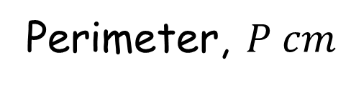

Perimeter, $P cm$
$$b cm$$
$$P=2\left(a+b\right)$$
$$a cm$$
$$118 cm$$
$$182 cm$$
$$118=P+2a$$
$$182=P+2b$$

Slide 4



Perimeter, $P cm$
$$b cm$$
$$P=2\left(a+b\right)$$
$$a cm$$
$$118 cm$$
$$182 cm$$
$$118=P+2a$$
$$182=P+2b$$
$300=3P$
$$300=2P+2\left(a+b\right)$$
Perimeter $=100 cm$

Slide 5



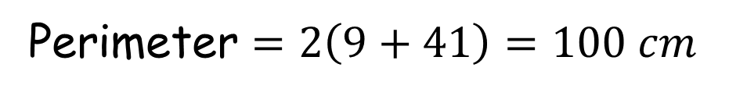





Or,
$118=4a+2b$ (1)
$182=2a+4b$ (2)
$236=8a+4b$ (1)x2 → (3)
$54=6a$ (3)-(2)
$a=9$
$$b=41$$
$$41 cm$$
$$9 cm$$
Perimeter $=2\left(9+41\right)=100 cm$

Slide 6


Tim and Tan
Tim and Tan each take an identical rectangular piece of card and each split them into two rectangles.
The combined perimeter of Tim’s rectangles was $118$ cm.
The combined perimeter of Tan’s rectangles was $182$ cm.
What was the perimeter of the original piece of card?
Is it possible to work out its dimensions?
$$100 cm$$
Yes, $9 cm$ $×41 cm$

Slide 7
Tim and Tan
Tim and Tan each take an identical rectangular piece of card and each split them into two rectangles.
The combined perimeter of Tim’s rectangles was $118$ cm.
The combined perimeter of Tan’s rectangles was $182$ cm.
What was the perimeter of the original piece of card?
Is it possible to work out its dimensions?
How did everyone get the same perimeter?
$$100 cm$$
Yes, $9 cm$ $×41 cm$

Slide 8

Tim and Tan
Tim and Tan each take an identical rectangular piece of card and each split them into two rectangles.
The combined perimeter of Tim’s rectangles was $A$ cm.
The combined perimeter of Tan’s rectangles was $B$ cm.
What was the perimeter of the original piece of card?
Is it possible to work out its dimensions?

Slide 9






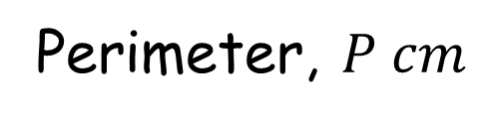

Perimeter, $P cm$
$$b cm$$
$$P=2\left(a+b\right)$$
$$a cm$$
$$A cm$$
$$B cm$$
$$A=P+2a$$
$$B=P+2b$$

Slide 10





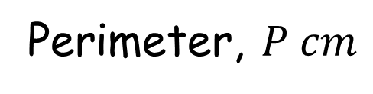





Perimeter, $P cm$
$$b cm$$
$$P=2\left(a+b\right)$$
$$a cm$$
$$A cm$$
$$B cm$$
$$A=P+2a$$
$$B=P+2b$$
$A+B=3P$
$$A+B=2P+2\left(a+b\right)$$
Perimeter $=\frac{1}{3}\left(A+B\right) cm$

Slide 11
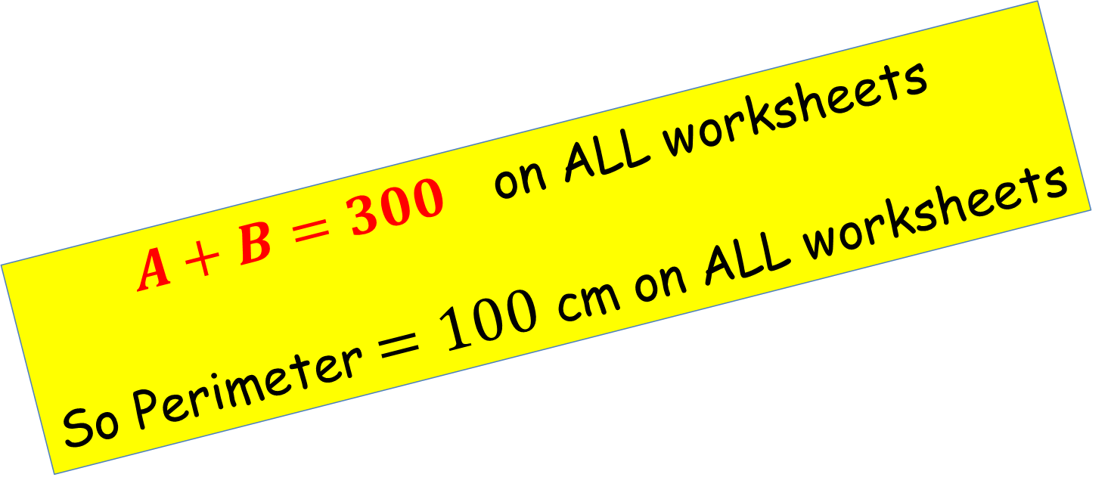
Tim and Tan
Tim and Tan each take an identical rectangular piece of card and each split them into two rectangles.
The combined perimeter of Tim’s rectangles was $A$ cm.
The combined perimeter of Tan’s rectangles was $B$ cm.
What was the perimeter of the original piece of card?
Is it possible to work out its dimensions?
$A+B=300$ on ALL worksheets
So Perimeter $=100$ cm on ALL worksheets

Slide 13
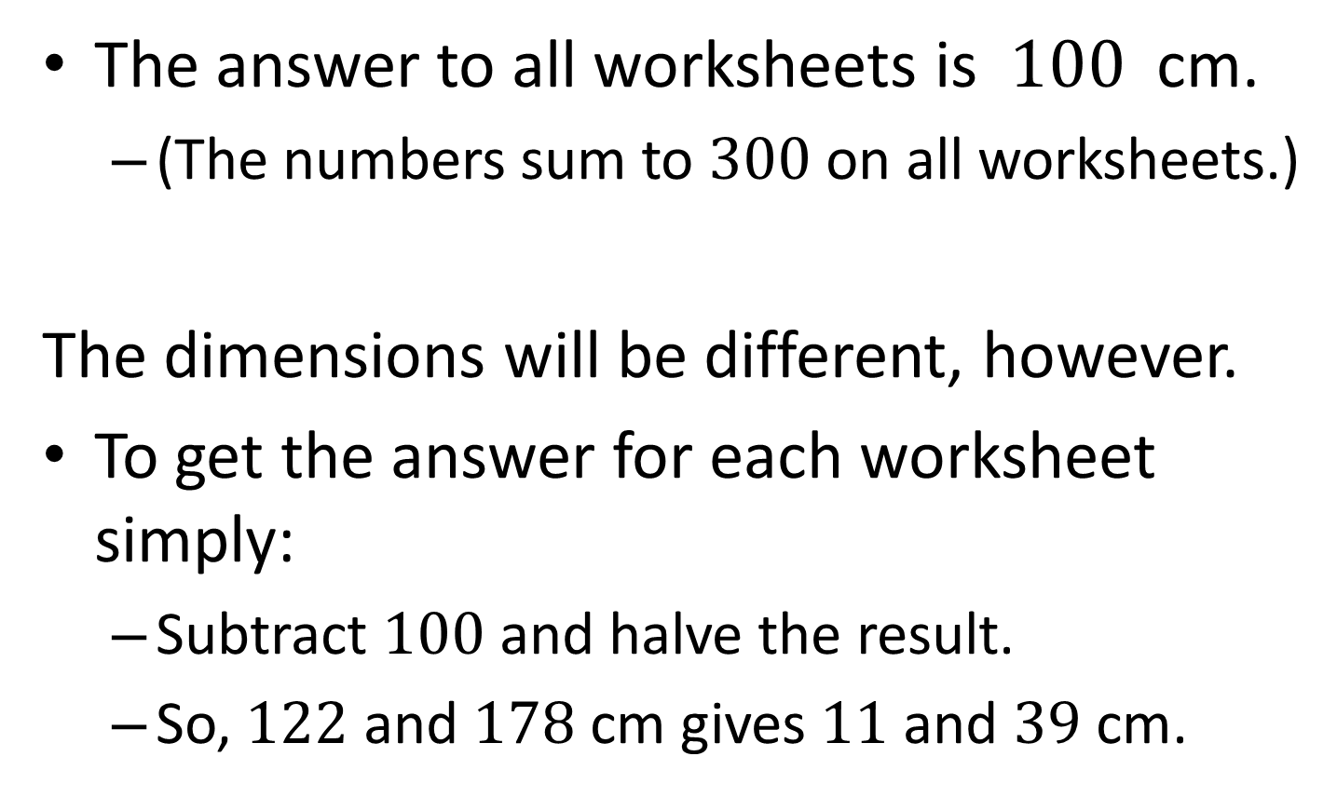
Note to Teacher - 1
The answer to all worksheets is $100$ cm.
  (The numbers sum to $300$ on all worksheets.)
The dimensions will be different, however.
To get the answer for each worksheet simply:
  Subtract $100$ and halve the result.
  So, $122$ and $178$ cm gives $11$ and $39$ cm.

Slide 14
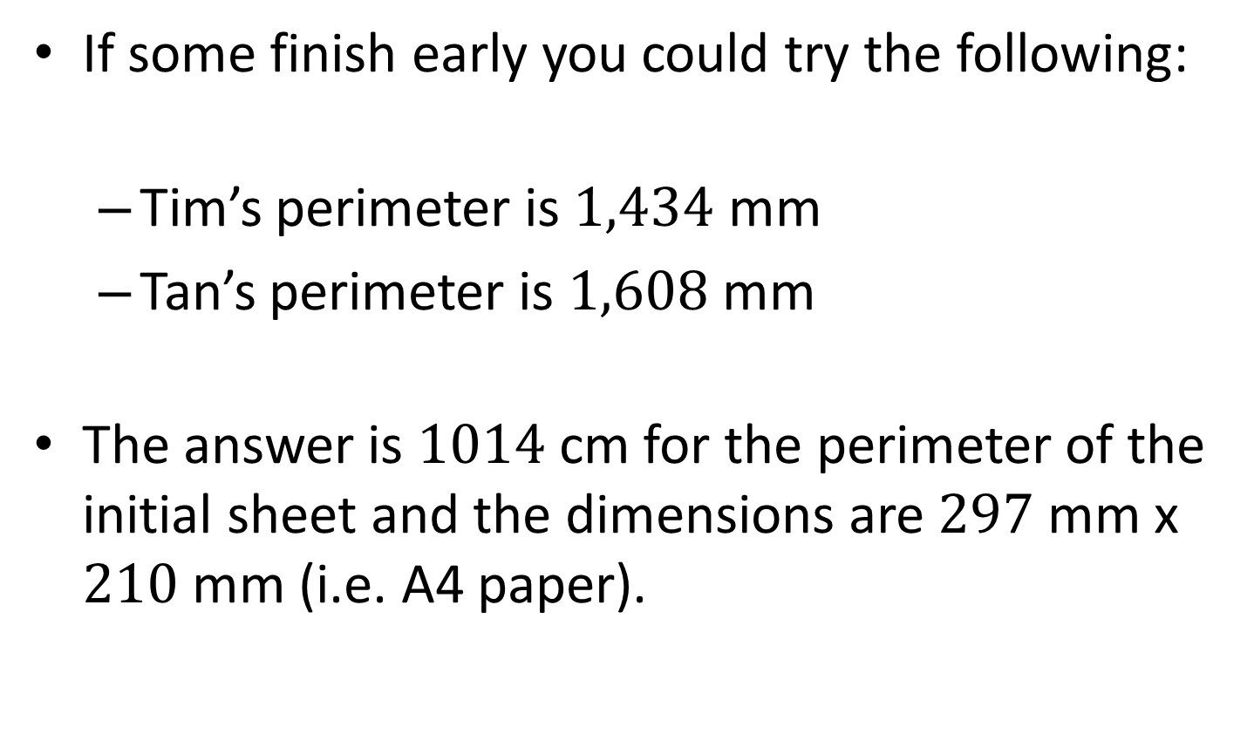
Note to Teacher - 2
If some finish early you could try the following:
  Tim’s perimeter is $1,434$ mm
  Tan’s perimeter is $1,608$ mm
The answer is $1014$ cm for the perimeter of the initial sheet and the dimensions are $297$ mm x $210$ mm (i.e. A4 paper).

Slide 15
RESOURCES

Slide 16

Tim and Tan
SIC_82
Tim and Tan each take an identical rectangular piece of card and each split them into two rectangles.
The combined perimeter of Tim’s rectangles was $120$ cm.
The combined perimeter of Tan’s rectangles was $180$ cm.
What was the perimeter of the original piece of card?
Is it possible to work out its dimensions?
A

Slide 17

Tim and Tan
SIC_82
Tim and Tan each take an identical rectangular piece of card and each split them into two rectangles.
The combined perimeter of Tim’s rectangles was $122$ cm.
The combined perimeter of Tan’s rectangles was $178$ cm.
What was the perimeter of the original piece of card?
Is it possible to work out its dimensions?
B

Slide 18

Tim and Tan
SIC_82
Tim and Tan each take an identical rectangular piece of card and each split them into two rectangles.
The combined perimeter of Tim’s rectangles was $124$ cm.
The combined perimeter of Tan’s rectangles was $176$ cm.
What was the perimeter of the original piece of card?
Is it possible to work out its dimensions?
C

Slide 19

Tim and Tan
SIC_82
Tim and Tan each take an identical rectangular piece of card and each split them into two rectangles.
The combined perimeter of Tim’s rectangles was $126$ cm.
The combined perimeter of Tan’s rectangles was $174$ cm.
What was the perimeter of the original piece of card?
Is it possible to work out its dimensions?
D

Slide 20

Tim and Tan
SIC_82
Tim and Tan each take an identical rectangular piece of card and each split them into two rectangles.
The combined perimeter of Tim’s rectangles was $128$ cm.
The combined perimeter of Tan’s rectangles was $172$ cm.
What was the perimeter of the original piece of card?
Is it possible to work out its dimensions?
E

Slide 21

Tim and Tan
SIC_82
Tim and Tan each take an identical rectangular piece of card and each split them into two rectangles.
The combined perimeter of Tim’s rectangles was $130$ cm.
The combined perimeter of Tan’s rectangles was $170$ cm.
What was the perimeter of the original piece of card?
Is it possible to work out its dimensions?
F

Slide 22

Tim and Tan
SIC_82
Tim and Tan each take an identical rectangular piece of card and each split them into two rectangles.
The combined perimeter of Tim’s rectangles was $132$ cm.
The combined perimeter of Tan’s rectangles was $168$ cm.
What was the perimeter of the original piece of card?
Is it possible to work out its dimensions?
G

Slide 23

Tim and Tan
SIC_82
Tim and Tan each take an identical rectangular piece of card and each split them into two rectangles.
The combined perimeter of Tim’s rectangles was $134$ cm.
The combined perimeter of Tan’s rectangles was $166$ cm.
What was the perimeter of the original piece of card?
Is it possible to work out its dimensions?
H

Slide 24

Tim and Tan
SIC_82
Tim and Tan each take an identical rectangular piece of card and each split them into two rectangles.
The combined perimeter of Tim’s rectangles was $136$ cm.
The combined perimeter of Tan’s rectangles was $164$ cm.
What was the perimeter of the original piece of card?
Is it possible to work out its dimensions?
I

Slide 25

Tim and Tan
SIC_82
Tim and Tan each take an identical rectangular piece of card and each split them into two rectangles.
The combined perimeter of Tim’s rectangles was $138$ cm.
The combined perimeter of Tan’s rectangles was $162$ cm.
What was the perimeter of the original piece of card?
Is it possible to work out its dimensions?
J

Slide 26

Tim and Tan
SIC_82
Tim and Tan each take an identical rectangular piece of card and each split them into two rectangles.
The combined perimeter of Tim’s rectangles was $140$ cm.
The combined perimeter of Tan’s rectangles was $160$ cm.
What was the perimeter of the original piece of card?
Is it possible to work out its dimensions?
K

Slide 27

Tim and Tan
SIC_82
Tim and Tan each take an identical rectangular piece of card and each split them into two rectangles.
The combined perimeter of Tim’s rectangles was $142$ cm.
The combined perimeter of Tan’s rectangles was $158$ cm.
What was the perimeter of the original piece of card?
Is it possible to work out its dimensions?
L

Slide 28

Tim and Tan
SIC_82
Tim and Tan each take an identical rectangular piece of card and each split them into two rectangles.
The combined perimeter of Tim’s rectangles was $143$ cm.
The combined perimeter of Tan’s rectangles was $157$ cm.
What was the perimeter of the original piece of card?
Is it possible to work out its dimensions?
M

Slide 29

Tim and Tan
SIC_82
Tim and Tan each take an identical rectangular piece of card and each split them into two rectangles.
The combined perimeter of Tim’s rectangles was $144$ cm.
The combined perimeter of Tan’s rectangles was $156$ cm.
What was the perimeter of the original piece of card?
Is it possible to work out its dimensions?
N

Slide 30

Tim and Tan
SIC_82
Tim and Tan each take an identical rectangular piece of card and each split them into two rectangles.
The combined perimeter of Tim’s rectangles was $145$ cm.
The combined perimeter of Tan’s rectangles was $155$ cm.
What was the perimeter of the original piece of card?
Is it possible to work out its dimensions?
O

Slide 31

Tim and Tan
SIC_82
Tim and Tan each take an identical rectangular piece of card and each split them into two rectangles.
The combined perimeter of Tim’s rectangles was $146$ cm.
The combined perimeter of Tan’s rectangles was $154$ cm.
What was the perimeter of the original piece of card?
Is it possible to work out its dimensions?
P

